Slide 1
CIS 490H/590J Edge Computing
Comparing Edge and Cloud
Winter 2023
Prof. Zheng Song
zhesong@umich.edu

Slide 2
Outline
Cloud Computing Characteristics
Edge/Cloud Differences
Requirements on the enabling technologies for edge computing

Slide 3
Cloud Computing Characteristics
scalability and elasticity
availability and reliability
accessibility and portability
performance and optimization
manageability and interoperability

Slide 4
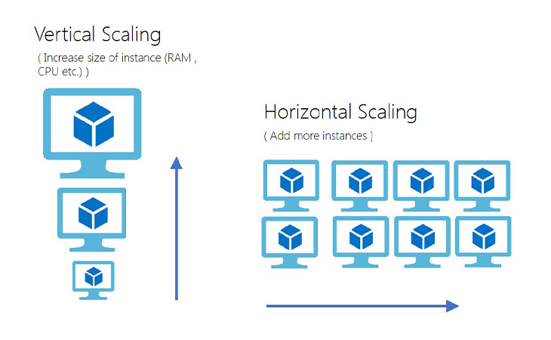
Scalability & Elasticity
What is scalability ?
The way you build your system: an application program would be scalable if it could be moved from a smaller to a larger operating system and take full advantage of the larger operating system in terms of performance (user response time and so forth) and the larger number of users that could be handled.
Two types of scalability:
Vertical scalability (scaling up)
Horizontal scalability (scaling out)

Slide 5
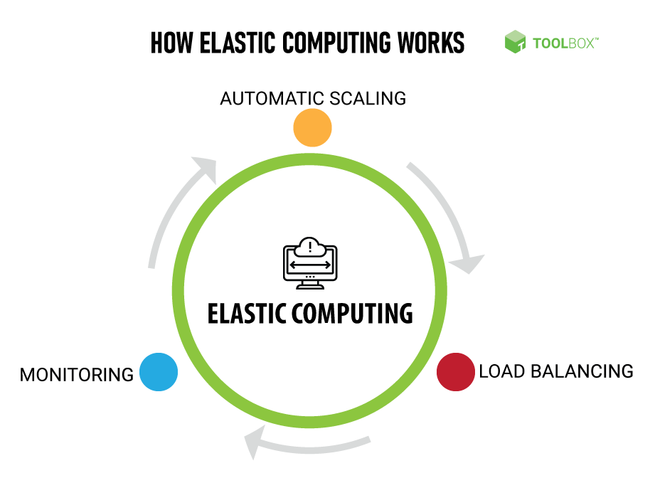
Scalability & Elasticity
What is elasticity ?
In its current deployment, can your application serve fluctuating users in a efficient way?
Less users: less resources
More users, more resources
Notes:
Where do resources that are saved go to (less users → less resources)?
They go to other applications → better efficiency.

Slide 6
Difference between scalability and elasticity
SCALABILITY - ability of a software system to process higher amount of workload on its current hardware resources or on current and additional hardware resources without application service interruption;
ELASTICITY - ability of the hardware layer below (usually cloud infrastructure) to increase or shrink the amount of the physical resources offered by that hardware layer to the software layer above. The increase / decrease is triggered by business rules defined in advance (usually related to application's demands). The increase / decrease happens on the fly without physical service interruption.

Slide 7
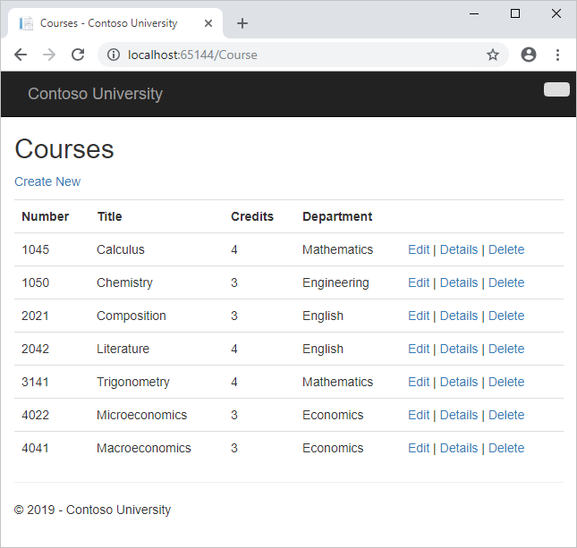
Example
Database:
1st Generation: excel database
Notes:
Problem with Excel database: it does not scale.
You cannot use another machine’s resources to speed up queries in the excel database.

Slide 8
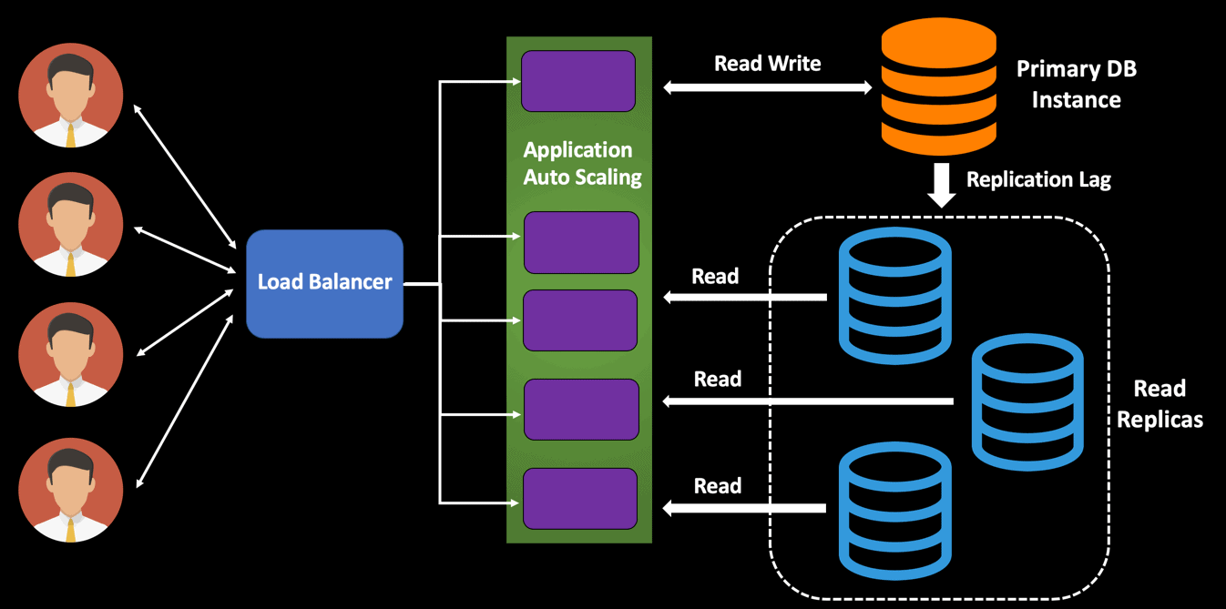
Example
Database
2nd generation: central/peripheral database
scalability/elasticity?
Notes:
Now we can handle more queries; provides scalability because read-only servers can be added to serve additional users.
But, it does not provide elasticity because you cannot scale down when less users are using the database.

Slide 9
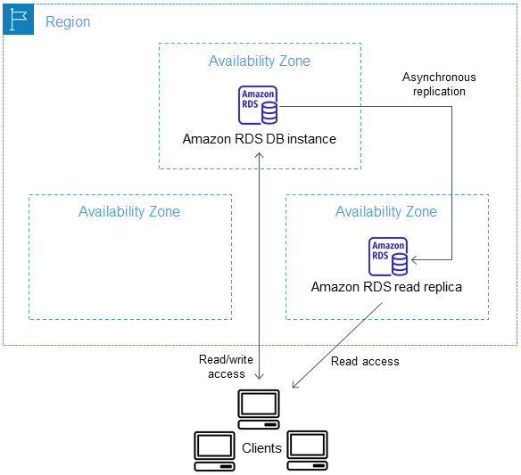
Example
Database:
3rd generation: amazon RDS
scalability/elasticity?
Notes:
Provides both scalability and elasticity, since resources in Amazon RDS are removed when not as many queries are required at a given time.

Slide 10

Relationship between scalability and elasticity
Cloud: Elasticity = scalability + automation + optimization auto-scaling
Enabling technologies:
Dynamic provisioning: change resources allocation at runtime
Multi-tenant design: virtualization and isolation
Notes:
Optimization: how you deploy/reduce the resources.

Slide 11
Availability and Accessibility
Availability (reliability)
Failure-free execution
Considerations in Cloud Computing
No single point of failure
Fault detection and isolation to the failing component
Fault containment to prevent propagation of the failure
Recover from failures
Notes:
Fault propagation: one server gets overwhelmed for example, then other servers start to get overwhelmed with request and fail…etc.

Slide 12
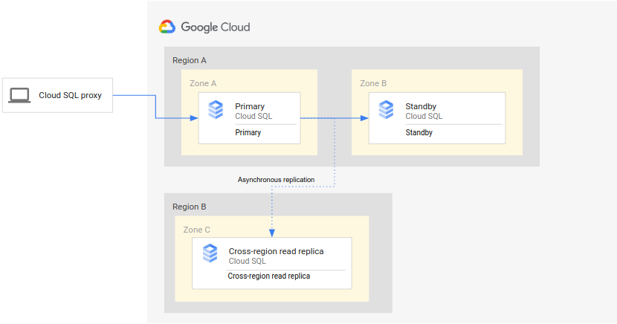
Cloud Computing Enabling Technologies for Availability
Replication
Service monitoring
Failure detection and automatic failover
Notes:
Cloud service providers spend a lot of money on replications to maintain availability.

Slide 13
Portability and Interoperability
Data portability means the ability to move data (files, documents, database tables, etc.) from one cloud system to another, and have that data usable in the other system.
Application Portability means the ability to move executable software from one cloud system to another, and be able to run it correctly in the destination system.
Interoperability means the ability of two cloud systems to talk to another, i.e. to exchange messages and information in a way that both can understand. (one client can work with two clouds)

Slide 14
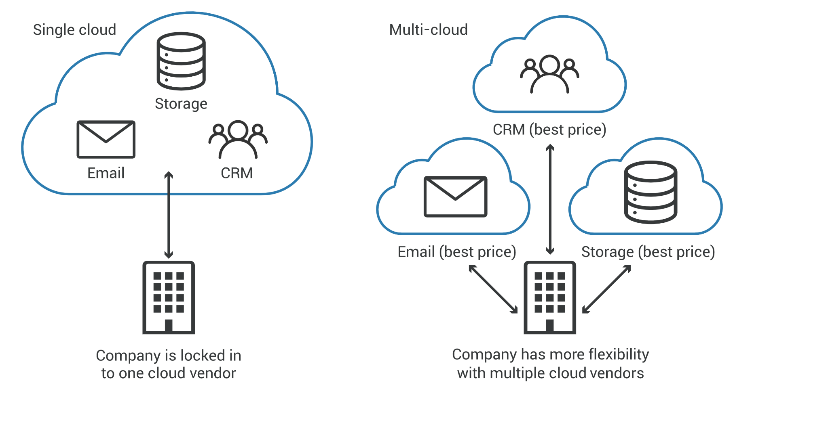
Vendor Lock-in Problem
Common in Cloud
Notes:
Caused by lack of interoperability with and between 2 or more clouds; vendor lock problem = you cannot migrate your data or parts of your data to another cloud (data center) and use their service.
Note: vendor locking is an even bigger problem with edge computing, since edge computing especially requires interoperability; such flexibility is necessary since edge computing resources can be limited but need to somehow be elastic, but building an elastic edge computing framework requires a distributed system with interoperability.

Slide 15
Properties that make edge different
Coverage
Cloud - indefinite resources, multi-tenant support, more users, service models => large geographical coverage
Edge - limited resources, less users at the edge, lack of multi-tenant support and standard service models => small geographical coverage

Slide 16
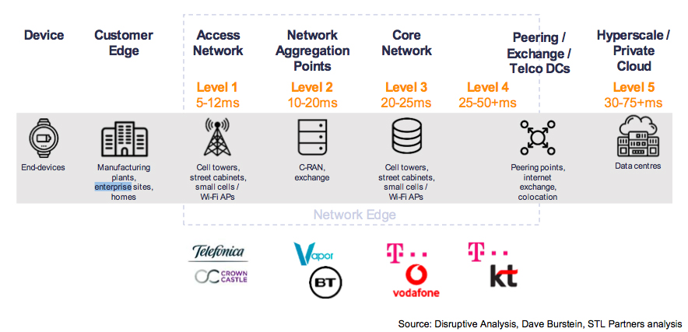
Properties that make edge different
Coverage

Slide 17
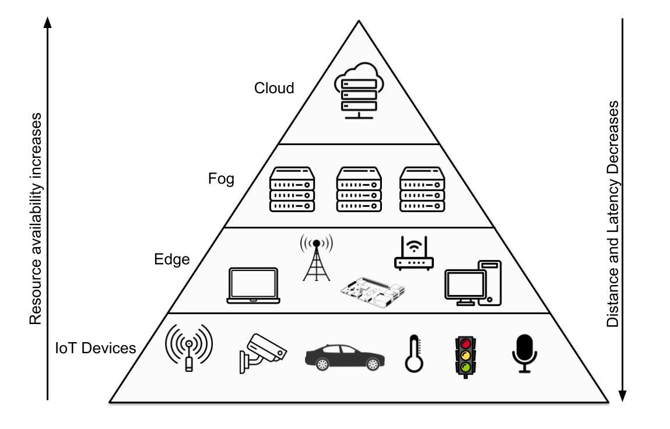
Properties that make edge different
Multilayered architecture Cloud - single layered, 3 standard service models (IaaS, PaaS, SaaS) Edge - multilayered (Mist, Edge, Fog, Cloud), no standard service models
Fig. Multilayered Architecture

Slide 18
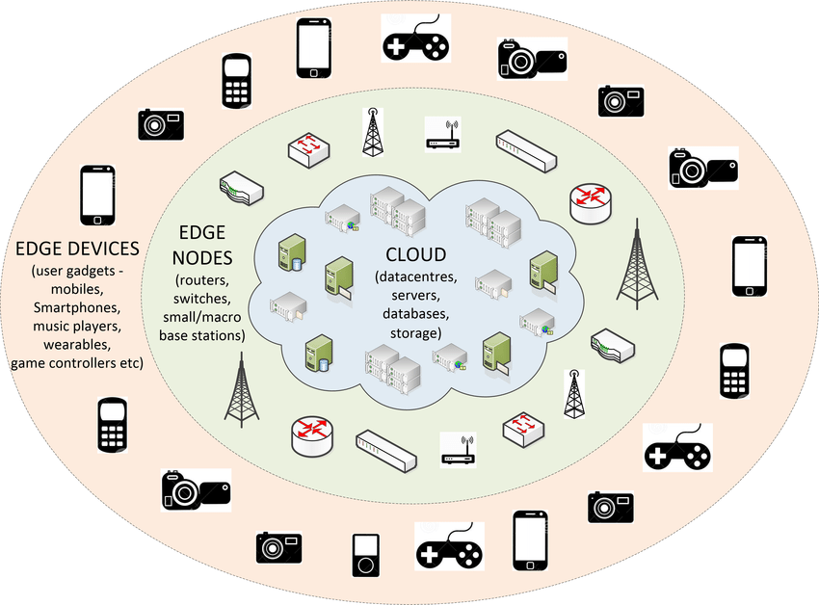
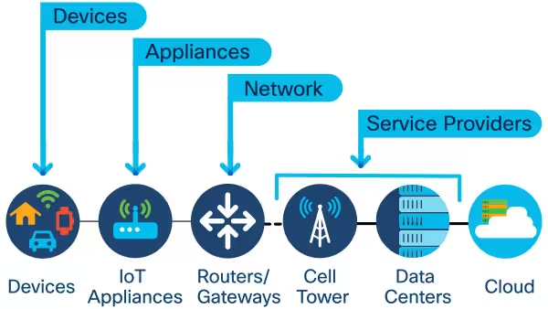
Properties that make edge different
Device Context
Represents devices’ location, environmental information, user’s information, device information (computation power, energy consumption)

Slide 19
Properties that make edge different
Resource heterogeneity
Represents distinct hardware characteristics such as CPU, processors, memory, network, etc., and their underlying OS, software stack, and programming models
Cloud - similar hardware specifications and runtime environments, e.g. centralized cloud servers (Amazon EC2 instances of various sizes and types such as t2.micro, t3.micro, etc. running Ubuntu)
Edge - dissimilar hardware characteristics, runtime environments, programming models, e.g. edge servers (less powerful than cloud servers and runs Ubuntu), home routers (less powerful than edge servers and runs OpenWRT), battery constrained IoT devices, microcontrollers, and sensors

Slide 20
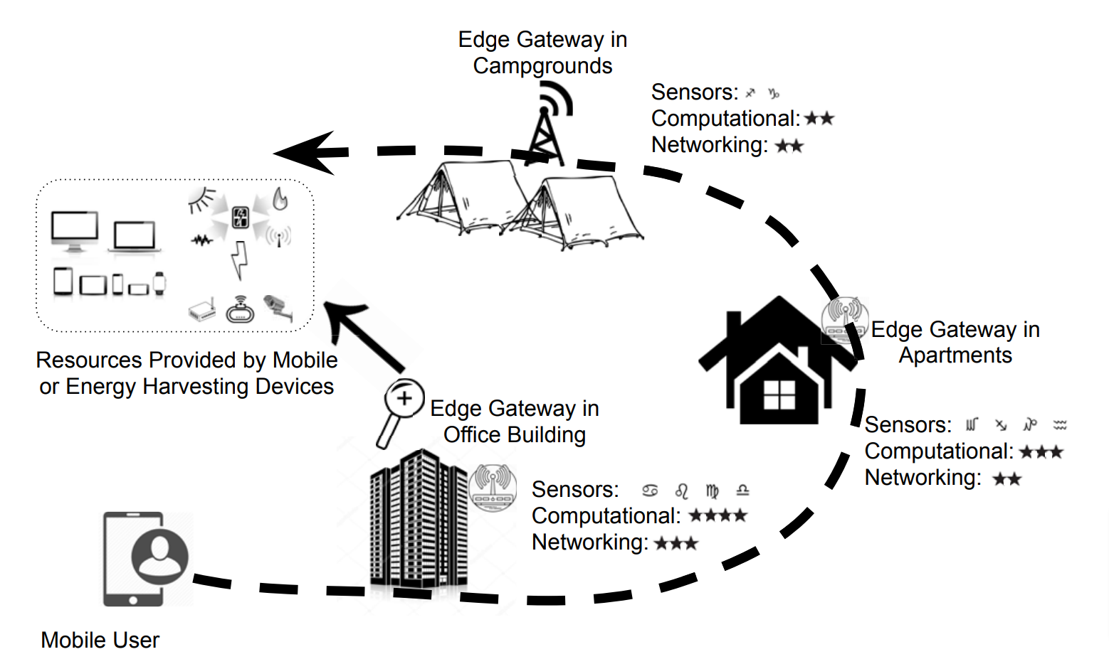
Properties that make edge different
Resource heterogeneity

Slide 21
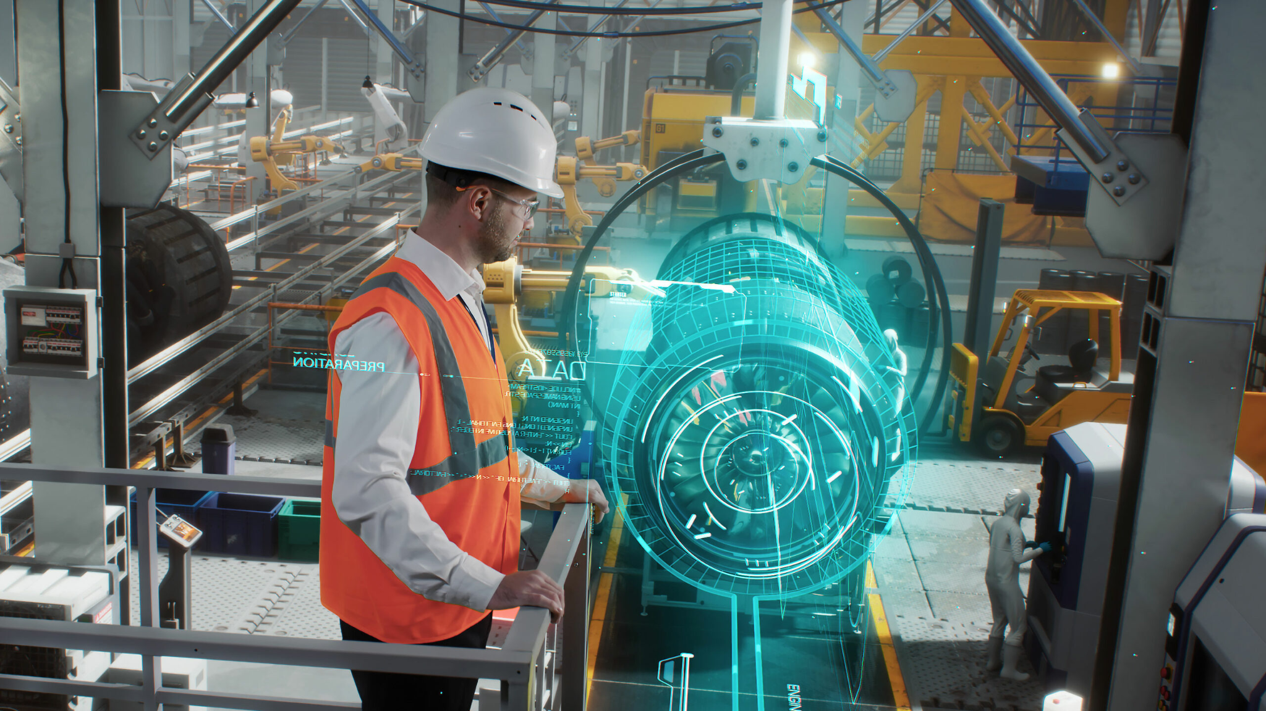
Properties that make edge different
QoS requirements
Latency critical applications such as AR/ VR, military and tactical networks, IoT applications, live video streaming

Slide 22
Properties that make edge different
Properties | Cloud | Edge
Network Coverage | Internet | Limited to LAN or MAN
Proximity | Far from end users, multiple hops | Close to end users, one or few hops
Number of clients | Unlimited | Limited
Layered Architecture | No | Yes
Device Context Awareness | Not required | Required
Resource Heterogeneity | No | Yes
Application-wise QoS considerations | No | Yes

Slide 23
Properties that make edge different
Properties | Cloud | Edge
End-to-end Latency | High | Low
Load on the Internet | High | Low
System Administration | Easy, as centralized | Difficult, as decentralized
Scalability & Elasticity | High, due to on-demand availability of additional resources | Low, due to limited resources
Computation & Storage Capacity | High | Low
Power consumption | High | Low

Slide 24
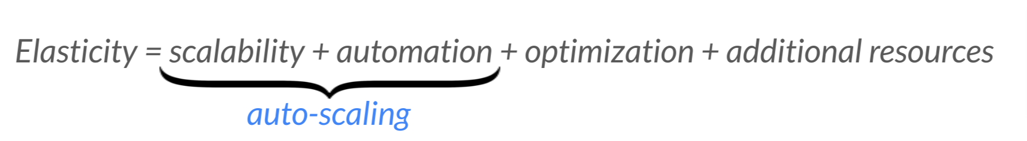
Requirements on Elasticity
Problem For Edge: resources scarcity
Deploying more resources: lower latency, lower utilization rate
Potential Solutions:
Better utilize the multi-layer structure
Better utilize local resources/ set priority for tasks
Work with cloud/fog/nearby edges
Dynamically add more resources (self-organized edge computing, car-mounted edge-computing center)
Notes:
There is a lower number available resources for edge computing, so we add additional resources to the elasticity equation for edge computing.

Slide 25
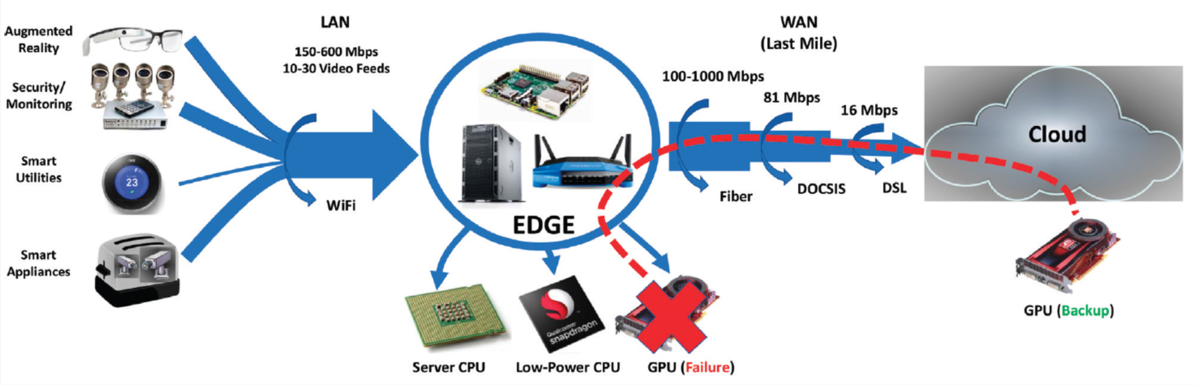
Requirements on Availability
Problem for edge: latency
Most edge embraces the by-default fail-over to the cloud solution to enhance availability

Slide 26
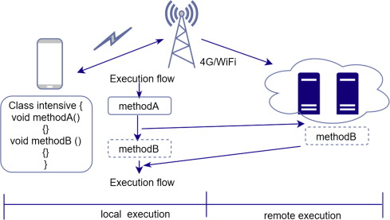
Requirements on Availability
Speculative Parallel Execution: Execute a task simultaneously on edge and cloud, returning the fastest result (how to minimize the extra (badnwidth) cost?)

Slide 27
Requirements on Interoperability
Vendor lock-in is not acceptable for edge computing
Cloud: Execution Latency = 300ms, Comm. Latency: AWS = 210ms, IBM = 230ms. Both are acceptable
Edge: AWS Edge = 20ms, IBM Edge = 30 ms. Only AWS Edge is acceptable
Different from cloud, there is only one edge server closest to the client!

Slide 28
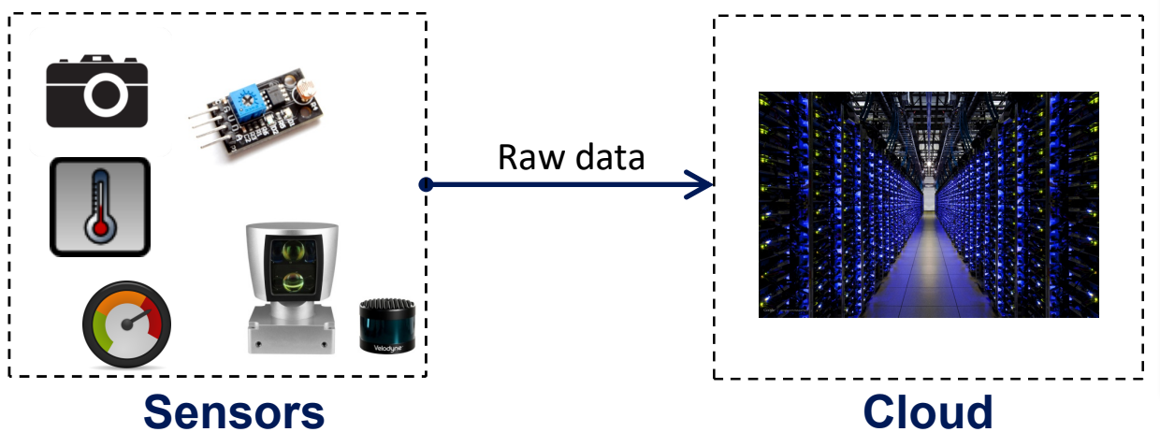
Recap: IoT + Edge + Cloud
Before Edge Computing
IoT: Sensing, limited resource/battery, more and more sensors/sensing methods
Cloud: Processing, seemingly unlimited resources, high latency

Slide 29
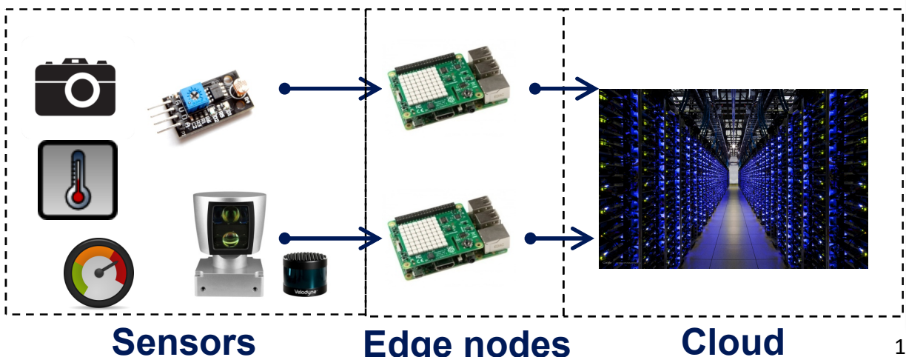
Recap: IoT + Edge + Cloud
With Edge: (send partially processed data) or (complete the entire process at edge)
Edge: more resource than sensors, less than cloud / low latency

Slide 30
Recap: IoT+Edge+Cloud
Cloud:
Basic:
XaaS,
QoS, SOA, SLA
Virtualization
Microservice/Serverless
Features:
Scalability and Elasticity: Virtualization + Multi-tenant
Availability: failure detection + redundancy
Accessibility: public IP / Domain name (can always access the closest duplicate of a service)
Performance:

Slide 31
Recap: IoT+Edge+Cloud
Edge:
Basic:
Different definitions: CDN / ISP / IoT / Mist
What edge devices / what functionalities / usage scenarios
Features:
Hierarchical
Less resources: hard to guarantee redundancy
Less users per site: hard to balance cost / scalability
Heterogeneous: different resources / service QoS at different edges
Closer to sensors: low interaction latency/cost

